Slide 1
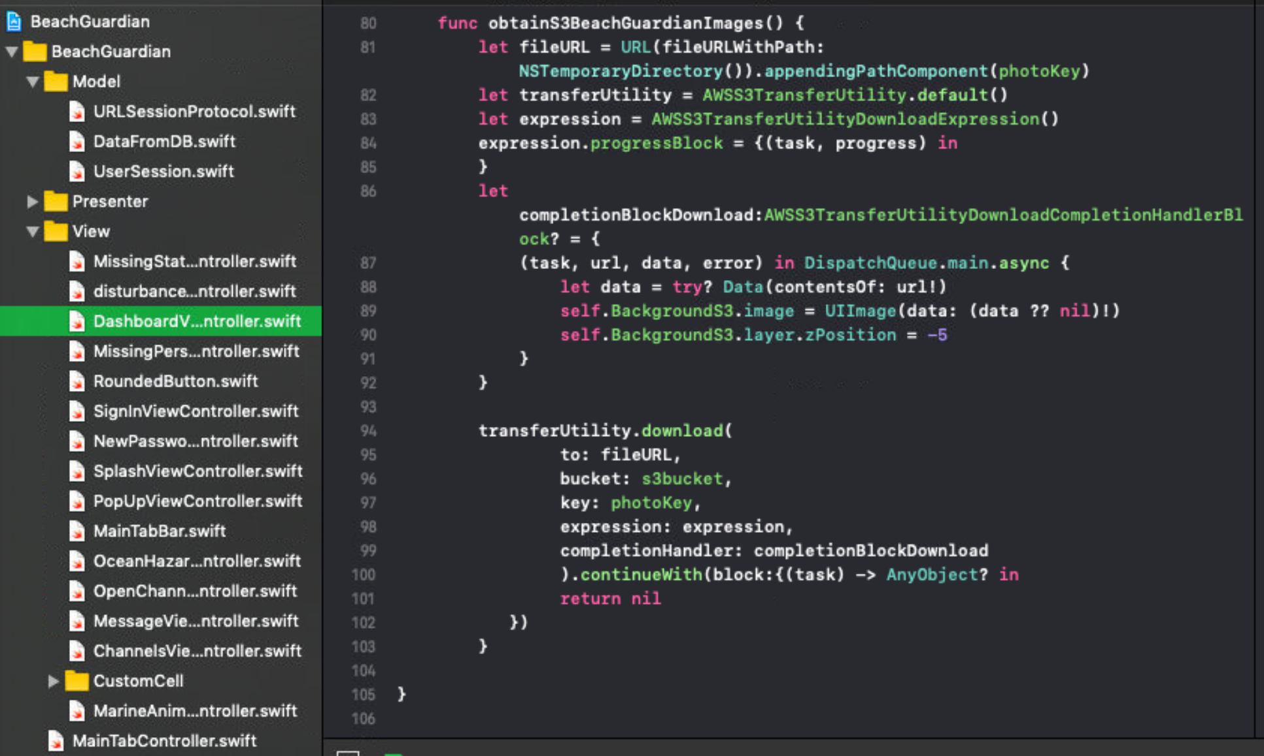
Edward – Week 12 (1)
Completed Tasks
Remove commented, unnecessary, and extra print statements
Add code and tests to S3 to marine Animals form
Cut down on warnings
Refactor S3 downloading process
Clean up tab bar
Remove disabled camera text

Slide 2
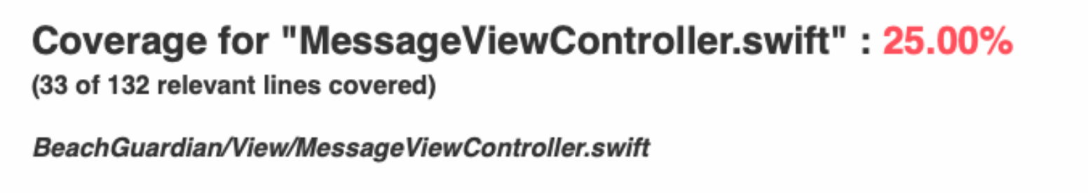
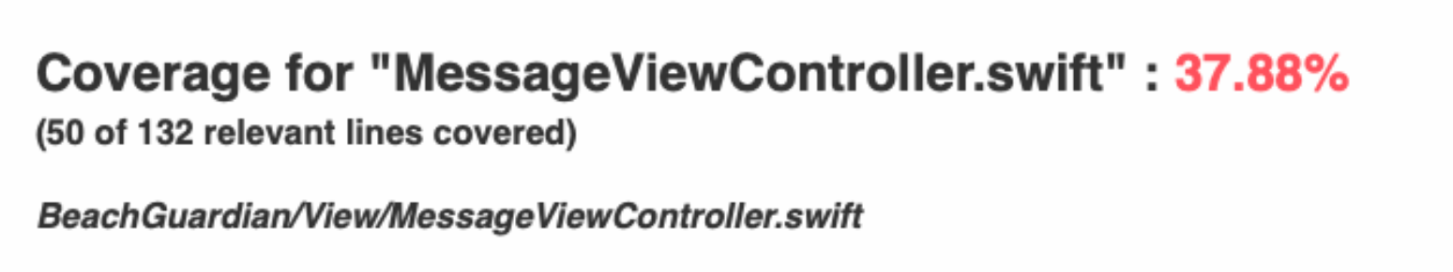
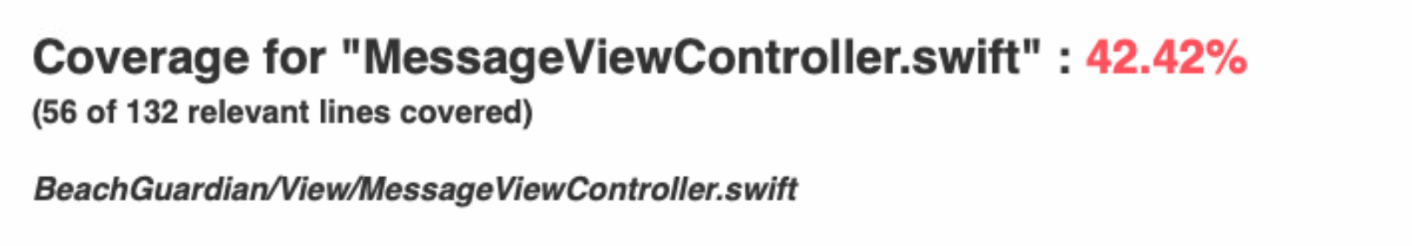
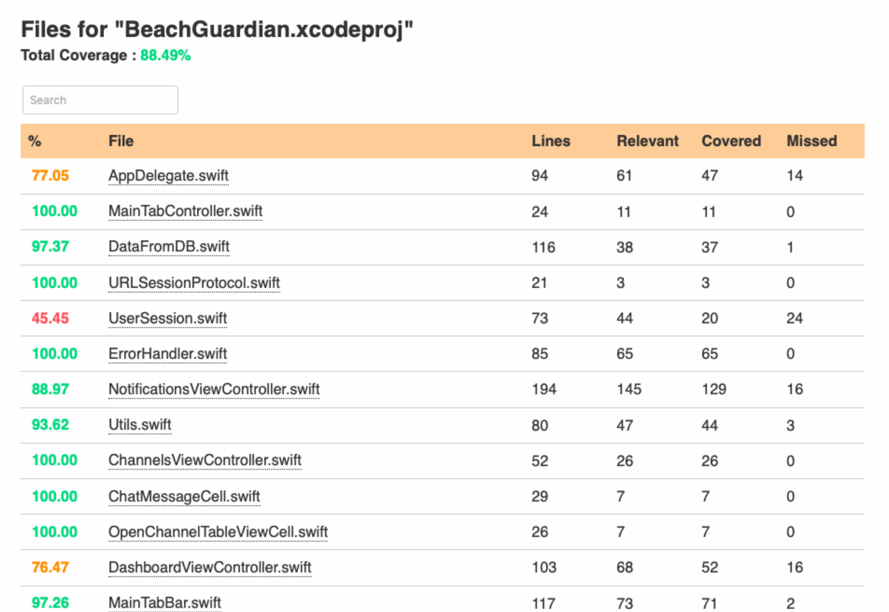
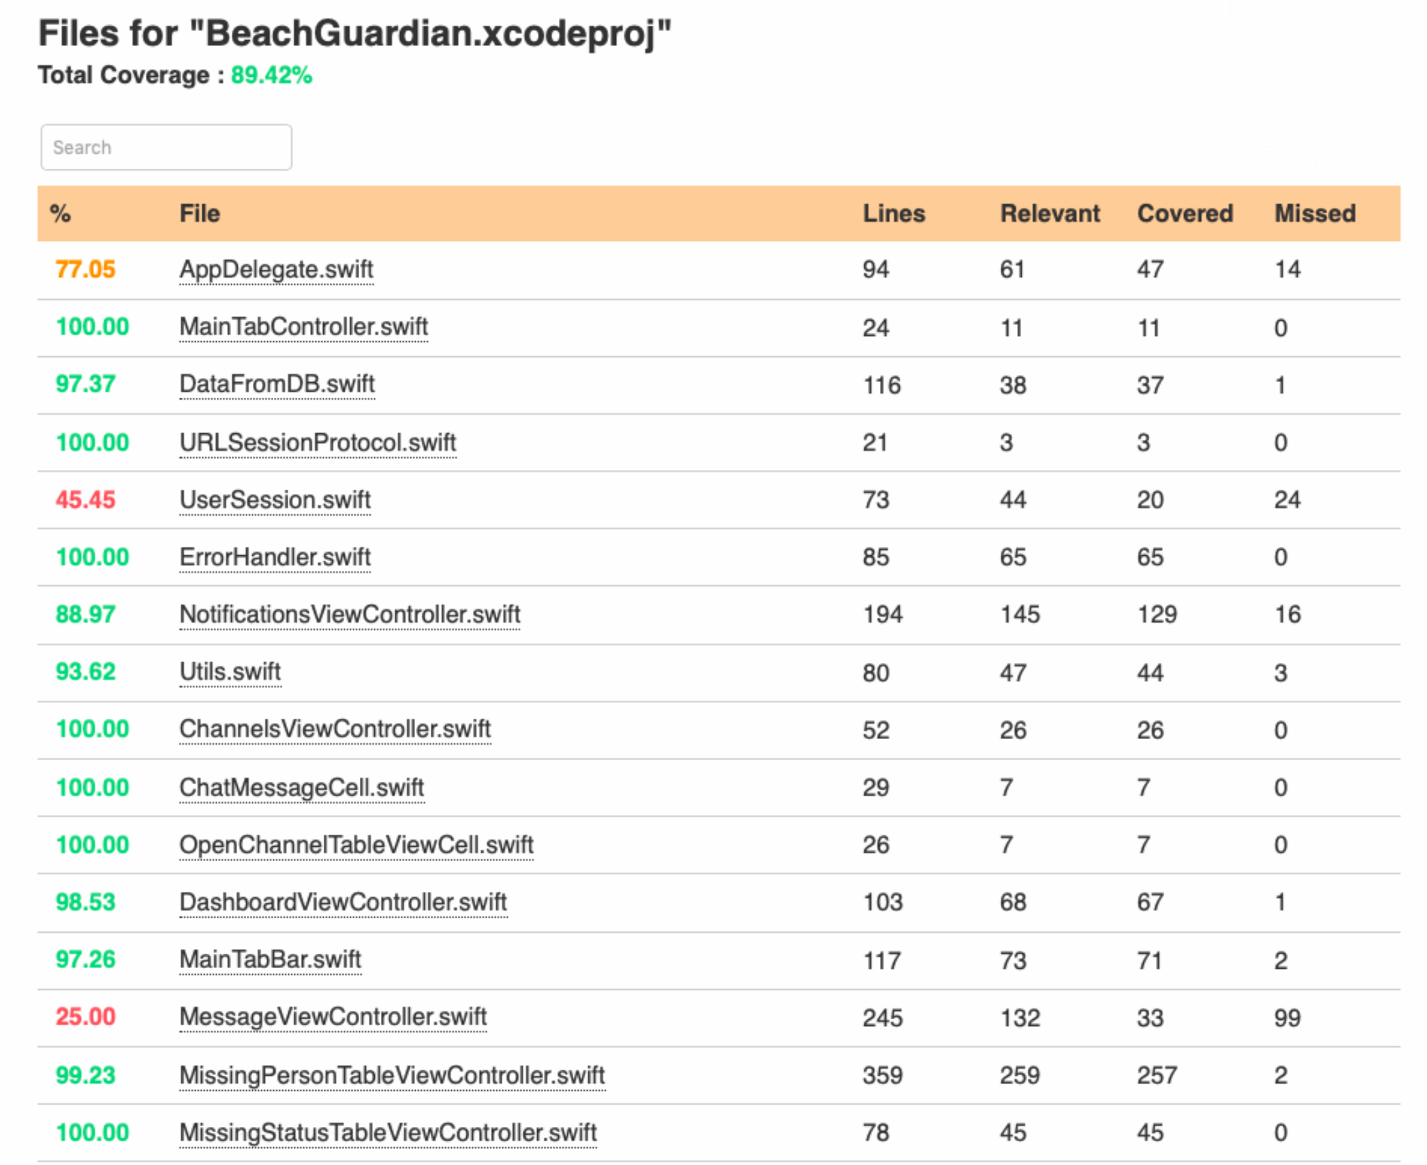
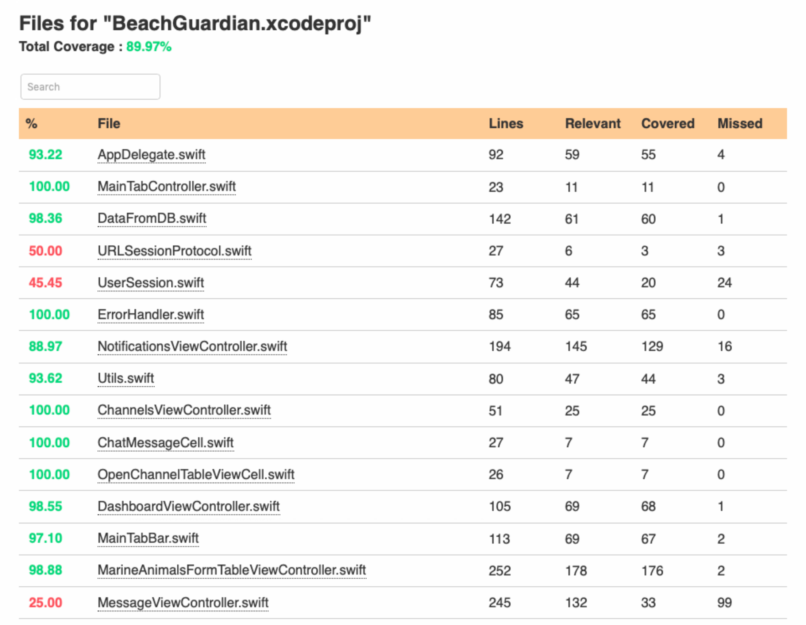
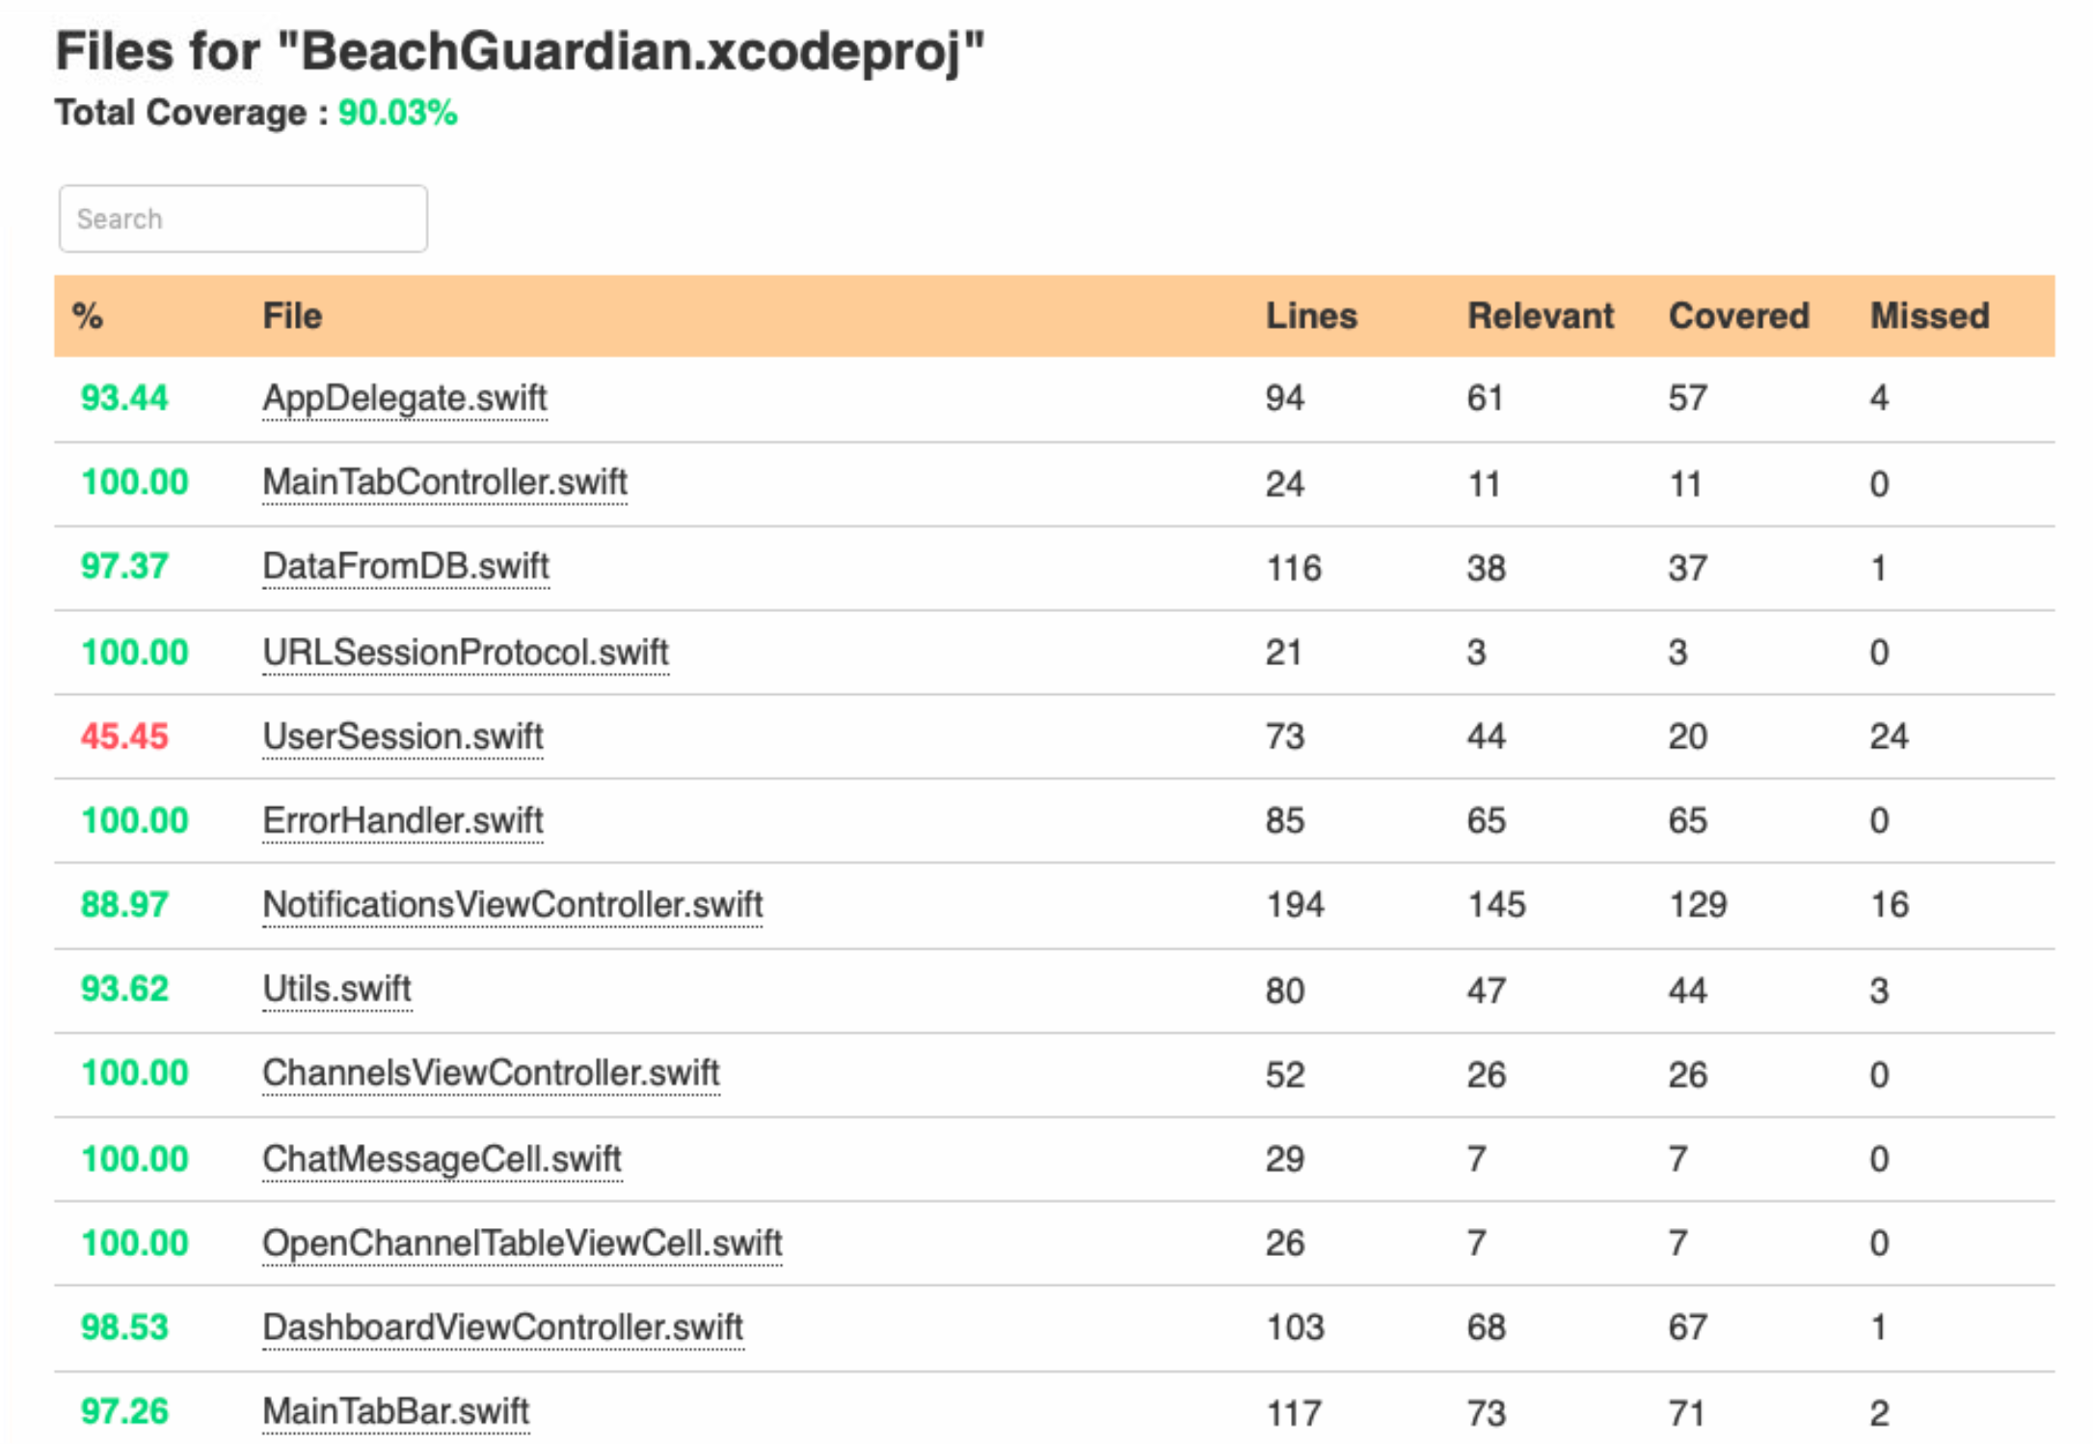
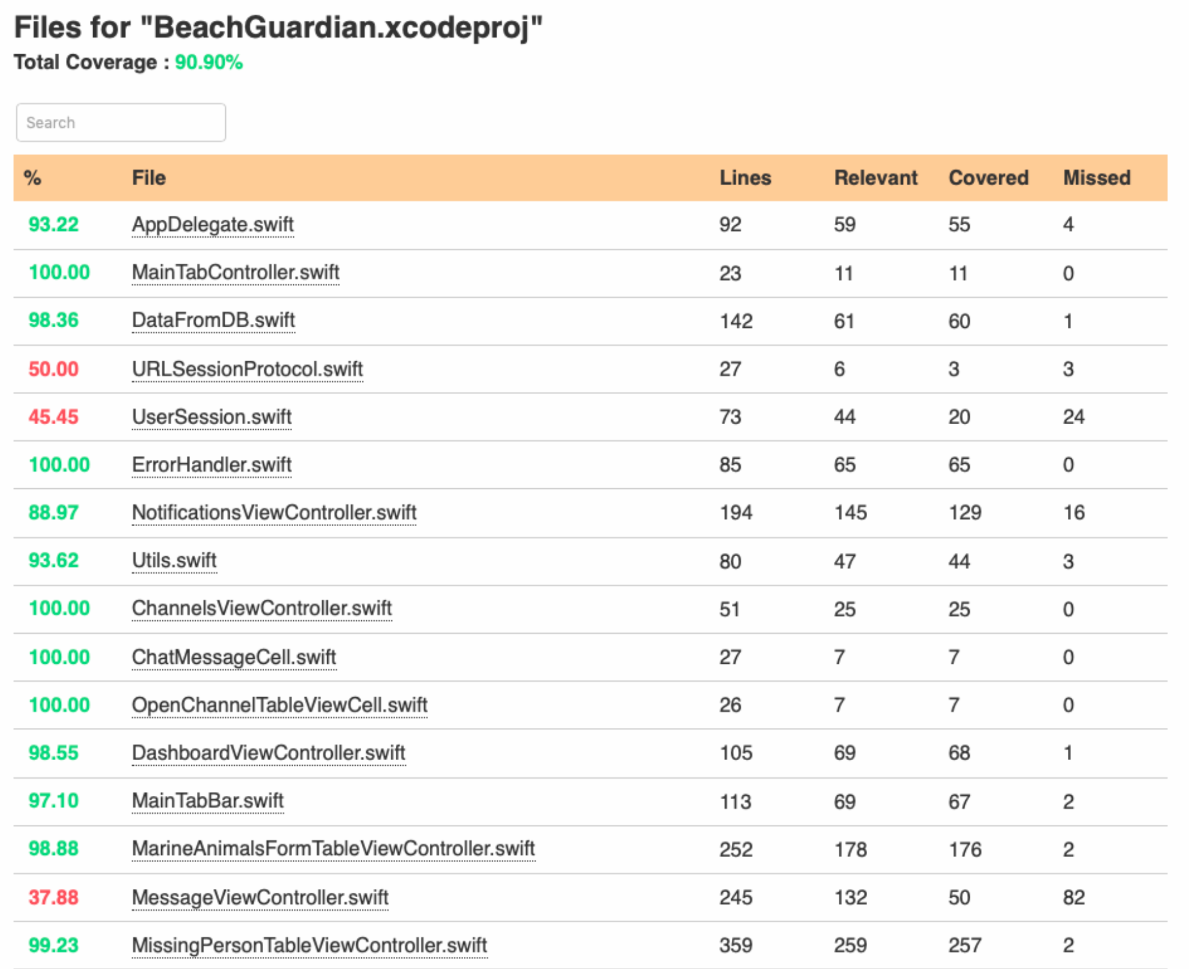
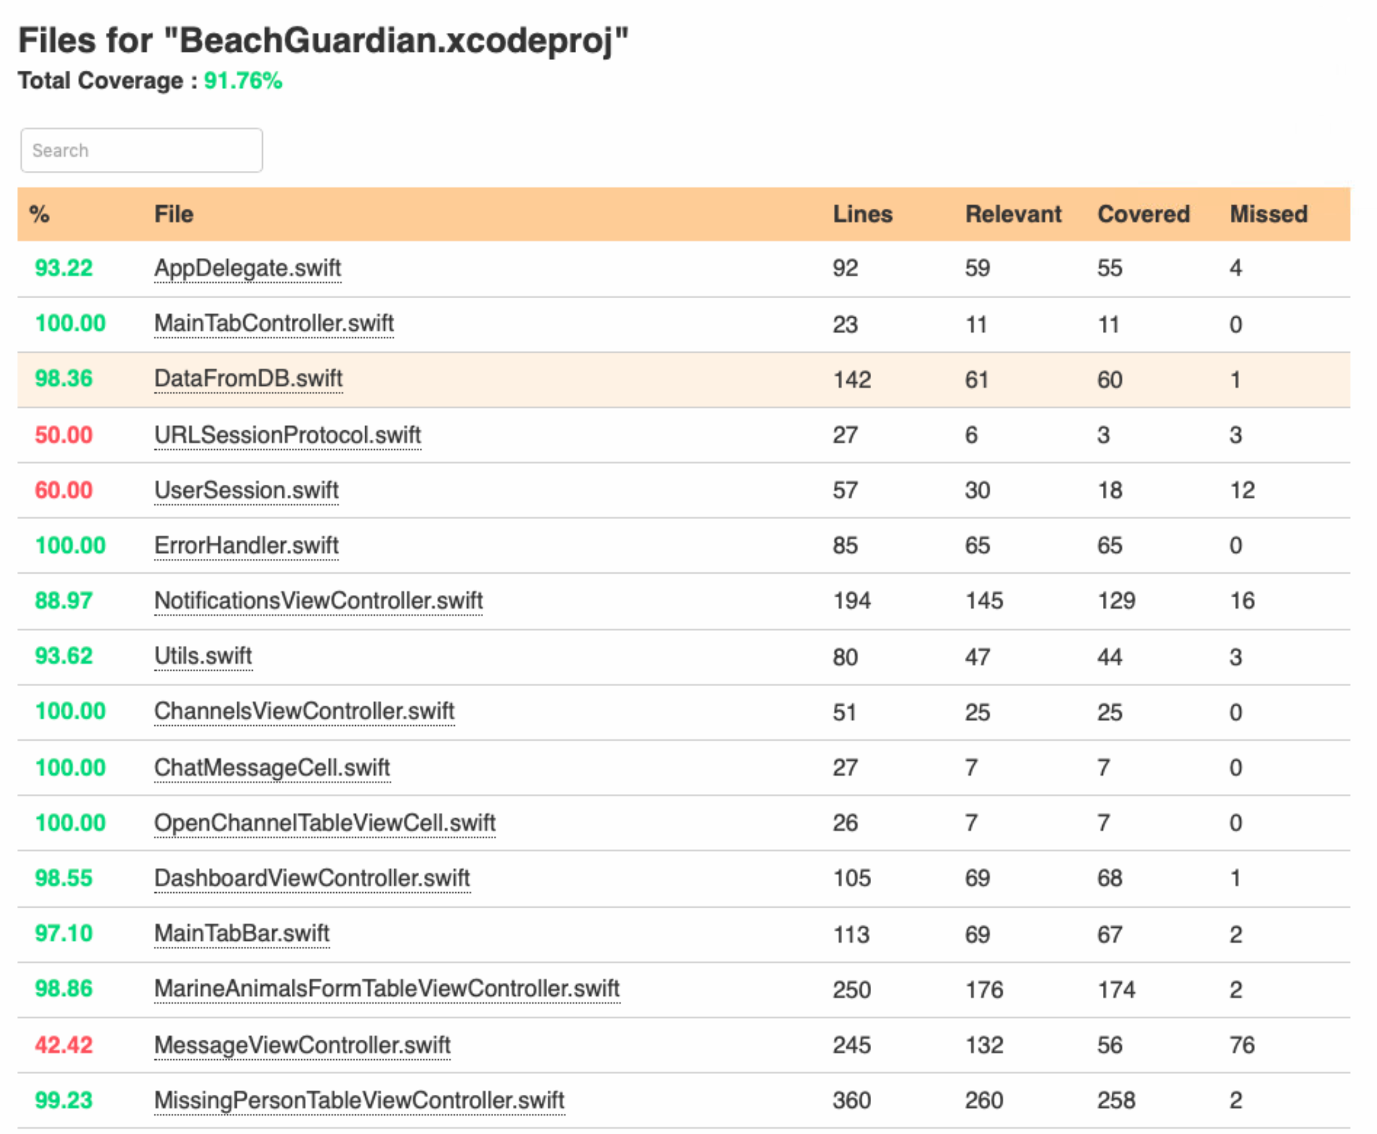
Edward – Week 12 (2)
Completed Tasks
Increase code coverage for:
AppDelegate.swift
MarineAnimalsFormTableViewController.swift
MessageViewController.swift
DashboardViewController.swift
Code coverage 92.27% at time of writing

Slide 3
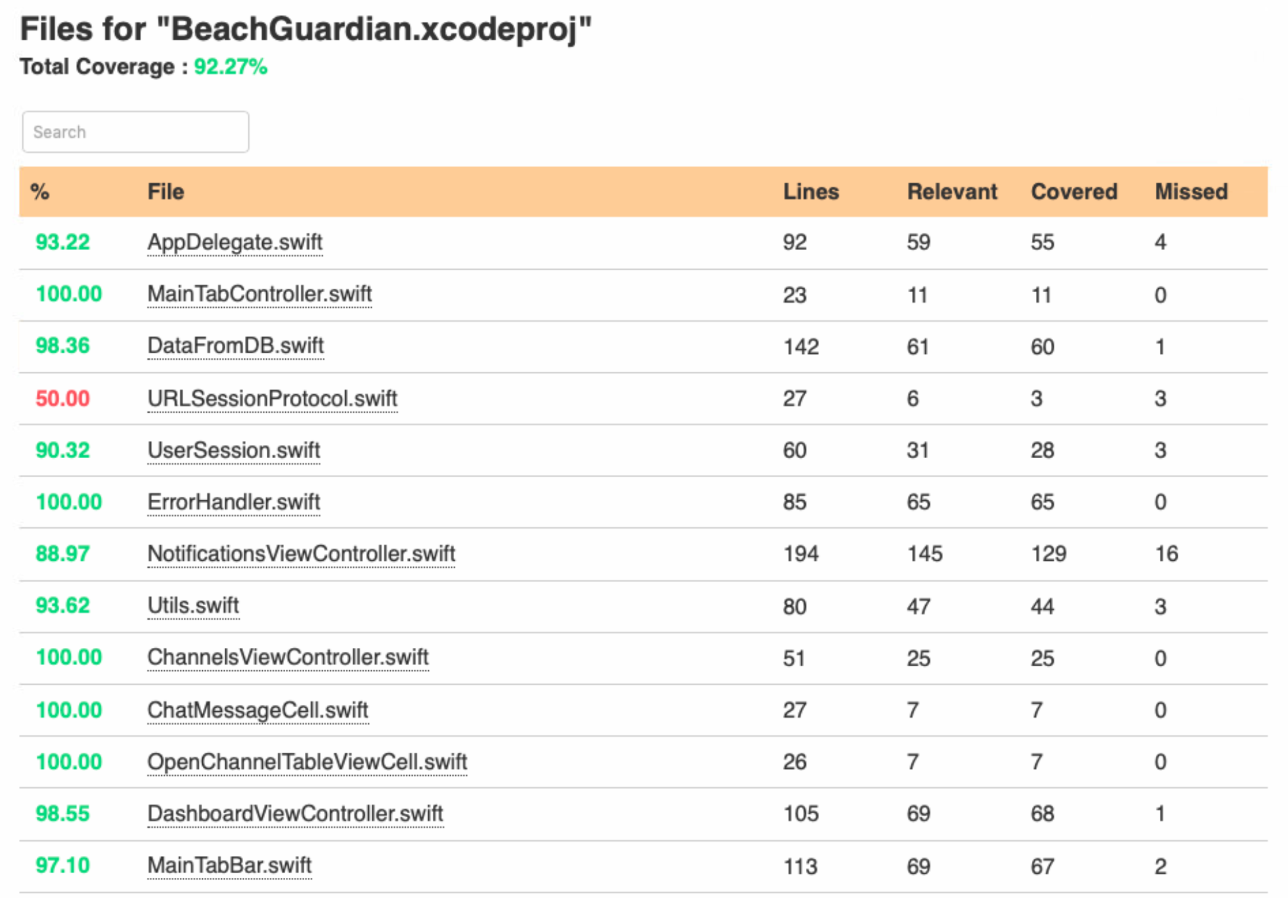
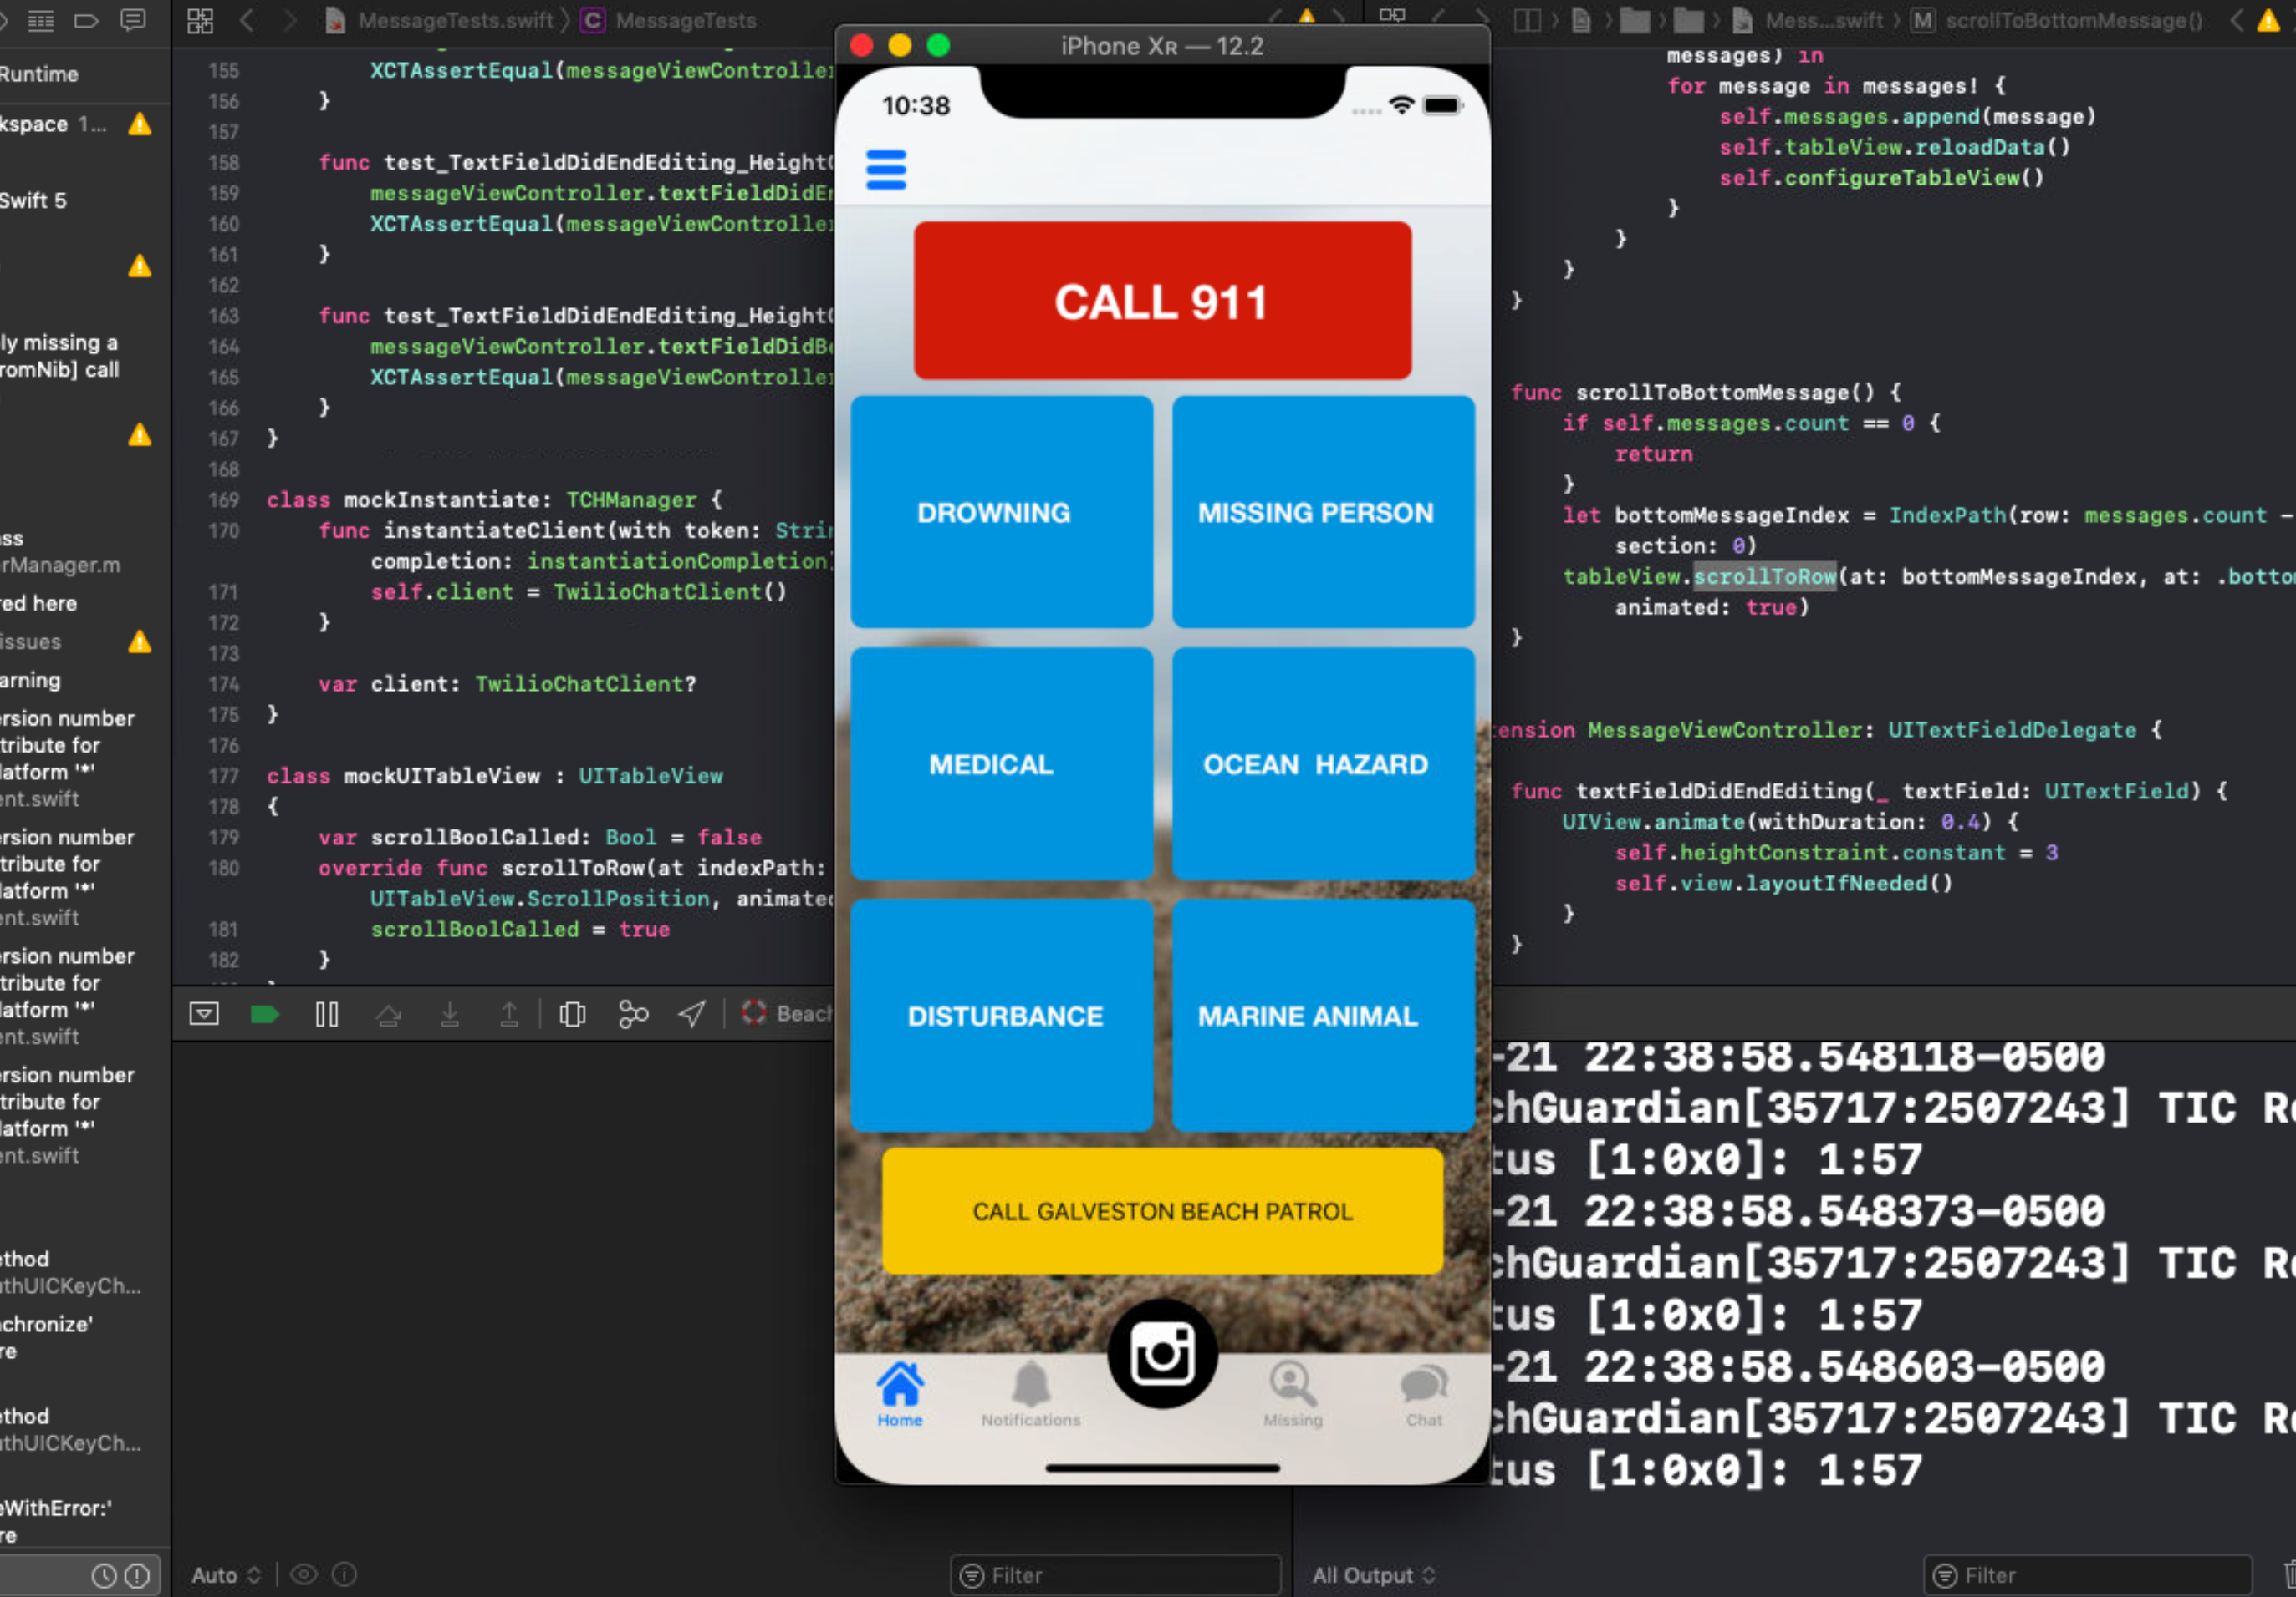
Edward Lie – Week 12 (3) In Progress Tasks
My week 13 goal is to help increase overall code coverage to 95+% with concentration on Twilio and URLSessionProtocol
Goal is to have all files at 90%+ coverage

